Slide 1

DEPARTMENT OF COMPUTER SCIENCE AND ENGINEERING CLOTHING STORE SYSTEM
MINI PROJECT IN C (19CSE39)
Student Name : B.Ajay Guided by,
Semester /Sec : 3-A Ms.Jayashree
USN : 1NH20CS039 Senior Assistant Professor
Department of CSE,
NHCE

Slide 2
CONTENTS
1)Introduction
2)Problem Statement
3)Objectives
4)Flow Chart
5)Hardware & Software Specification
6)Module description
7)Code Implementation
8)Use of the mini-project
9)Conclusion

Slide 3
INTRODUCTION
Clothing store System Project is a simple console application designed to demonstrate the practical use of C programming language with data structure and its features .
This mini-project is an effective management system which is very useful for clothing shop owners to manage the stocks of the different clothing items available in the shop.
with the help of this program, Clothing shop owners can manage the stocks of clothing items themselves by entering the details of the amount of clothing items bought from the wholesaler and the amount of items sold to the customer.
When the user enters these details ,the program will automatically compute the stock details and display it to the user.
an extra feature has also been provided where the program displays the daily sales report.

Slide 4
PROBLEM STATEMENT
We can see that clothing shop owners employ an inventory manager who uses a register book to update the stock details manually.
This is a very time consuming and tedious process as they have to note down each and every transaction as and when there is a purchase or sale.
This can be a very inefficient way to run a store because it can consume a lot of time ad resources.
With the help of this program we can eliminate the need to maintain the stock details manually.
This can make life much easier for clothing shop owners to maintain the stock details by themselves with a help of a few clicks on their computer.

Slide 5
OBJECTIVES
The main aim of this mini-project is to create an application which can be used in clothing store to make the process of updating the stock items as easy and hassle free as possible.
The main objective of this mini-project is to make life easier for clothing shop owners by minimizing the complexity involved in managing the stock details of the store.
To provide a user friendly interface so that user can enter the stock details and any other information regarding purchase or sale of clothing items easily and get the updated stock details instantly.
To provide the owner with the daily sales report so that they know which items are liked by the customers,with the help of which they can plan a new sale to increase profits.

Slide 6
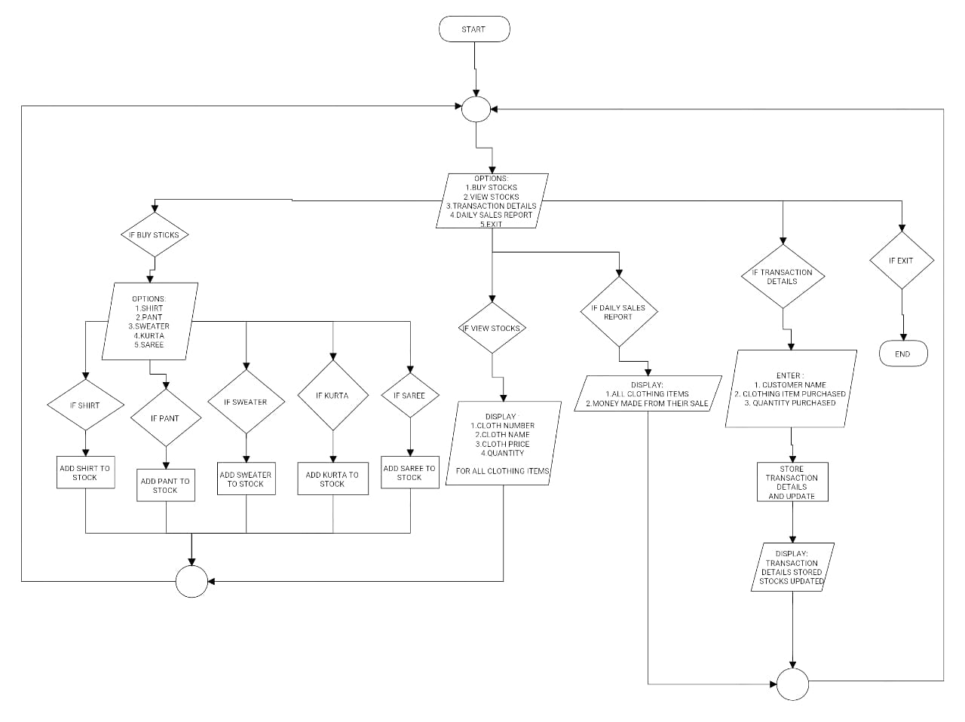
FLOW CHART

Slide 7
HARDWARE AND SOFTWARE SPECIFICATION
Operating system : Microsoft Windows/XP/Vista/Windows 7/Windows 10
Processor : 800 MHz Intel Pentium III or better.
Memory : 2GB or more.
Disk Space : 512 MB of free disk space or more
Software : C Compiler

Slide 8
FUNCTIONS USED
buystock() : this function is used to add clothing items o stock when items are purchased from the wholesaler
viewstock() :This function is used to view all the clothing items and their quantities which are left in stock.
transdetails() :This function is used to remove clothing items from stock when a customer purchases few items.
dailyreport() : this function is used to display the different clothing items sold and the total money made from the sale of each type of clothing item.
setvalue() : this function is used to set all the values of members of the node to 0 or NULL.this fuction is used at the beginning o the program to initialize all values.

Slide 9
IMPLEMENTATION MODULE 1 FUCTIONALITY
#include<stdio.h>
#include<conio.h>
#include<string.h>
#include<stdlib.h>
struct cloth
{
int clothno;
char clothname[10];
int clothprice;
int qty;
int soldqty;
struct cloth *link;
};
This structure is used to implement singly liked list in the program.
It contains 5 fields that is used to store the details such as : number,name,item,price,quantity of clothing item.

Slide 10
MODULE 2 FUNCTIONALITY
scanf("%d",&cqty);
shirt->soldqty=shirt->soldqty+cqty;
shirt->qty=shirt->qty-cqty;
printf("\n\nTRANSANCTION DETAILS STORED \nSTOCKS UPDATED\n");
getch();
}
else if(strcmp(cname,"pant")==0)
{
printf("\n\nhow many %ss did %s purchase? ",cname,custname);
scanf("%d",&cqty);
pant->soldqty=pant->soldqty+cqty;
pant->qty=pant->qty-cqty;
void transdetails()
{
char custname[10],cname[10];
int cqty;
printf("Enter customer name: ");
scanf("%s",custname);
c:
printf("\n\nwhat clothing item did %s purchase? ",custname);
scanf("%s",cname);
if(strcmp(cname,"shirt")==0)
{
printf("\n\nhow many %ss did %s purchase? ",cname,custname);

Slide 11
printf("\n\nTRANSANCTION DETAILS STORED \nSTOCKS UPDATED\n");
getch();
}
else if(strcmp(cname,"sweater")==0)
{
printf("\n\nhow many %ss did %s purchase? ",cname,custname);
scanf("%d",&cqty);
sweater->soldqty=sweater->soldqty+cqty;
sweater->qty=sweater->qty-cqty;
printf("\n\nTRANSANCTION DETAILS STORED \nSTOCKS UPDATED\n");
getch();
}
else if(strcmp(cname,"kurta")==0)
{
printf("\n\nhow many %ss did %s purchase? ",cname,custname);
scanf("%d",&cqty);
kurta->soldqty=kurta->soldqty+cqty;
kurta->qty=kurta->qty-cqty;
printf("\n\nTRANSANCTION DETAILS STORED \nSTOCKS UPDATED\n");
getch();
}
else if(strcmp(cname,"saree")==0)
{
printf("\n\nhow many %ss did %s purchase? ",cname,custname);
scanf("%d",&cqty);
saree->soldqty=saree->soldqty+cqty;

Slide 12
saree->qty=saree->qty-cqty;
printf("\n\nTRANSANCTION DETAILS STORED \nSTOCKS UPDATED\n");
getch();
}
else
{
printf("\n\nEnter the cloth name correctly \n");
goto c;
}
}
The above module is used to enter the transaction details
automatically subtract the value from the stock of the clothing item which is already available.
In this module the program asks for the input for the name of the customer ,name of the clothing item bought by the customer and the quantity bought by the customer.
These details are stored and used to compute the new value of the available stock of that particular clothing item.

Slide 13
DATA STRUCTURE USED
In my mini-project ,I have used the concept of linked list which is a data structure.
I have created a structure ,with the help of which I have created different nodes for different clothing items like shirt,pant,sweater etc.
These nodes are connected with help of linked list. Whenever a need arises to update the stock details, I can traverse through this linked list and find the clothing item whose details need to be updated.
I have also added another functionality in this clothing store system mini project with the help of linked list to display the daily sales report.

Slide 14
USE OF MY MINI-PROJECT
My mini project can be very useful for clothing shop owners in updating the stock details.
It can be useful as it provides a daily sales report with the help of which owners can get to know what products are in higher demand so that they can increase profits.
Moreover, my mini-project can also be extended/modified to suit any other store like department store, grocery store etc.so this mini project has a wide range of applications.

Slide 15
CONCLUSION
Clothing store System Project is a simple console application designed to demonstrate the practical use of C programming language with data structure and its features .
Working with This project helped me get clear understanding various concepts of data structures and structures in c programming language .
I also learned how to write and analyze the algorithm for a problem statement.I also gained more experience in working with the c compiler.
By working with my mini-project,I was able to create an application to minimize the complexity involved in updating stocks of a clothing store.

Slide 16
THANK YOU

